Slide 1
“I know thy works”
The Letters to the Seven Ecclesias
Revelation 2 & 3

Slide 2
“The challenge of remaining steadfast to the end”
Study 3
Revelation 2:18-29

Slide 3
Thyatira
The least notable city of all seven, historians record little of it in the 200 years before AD 96.
Was fortified by the Greeks as a military fortress because it stood in the Lycus Valley which ran north and south joining the Hermus and Caicas valleys.
Losing its military significance during Roman times it became a large and prosperous commercial centre.

Slide 4
Thyatira
80 kms (50 miles) east of Pergamos, it was that royal city’s guard post to slow down invaders from the east.
Noted for its trade guilds (e.g. Guild of the Dyers), every skilled worker was a member of a union and was expected to support his association.
Truth started here by the work of Lydia (converted at Philippi - Acts 16:14), and Paul while at Ephesus (Acts 19:8-10).

Slide 5
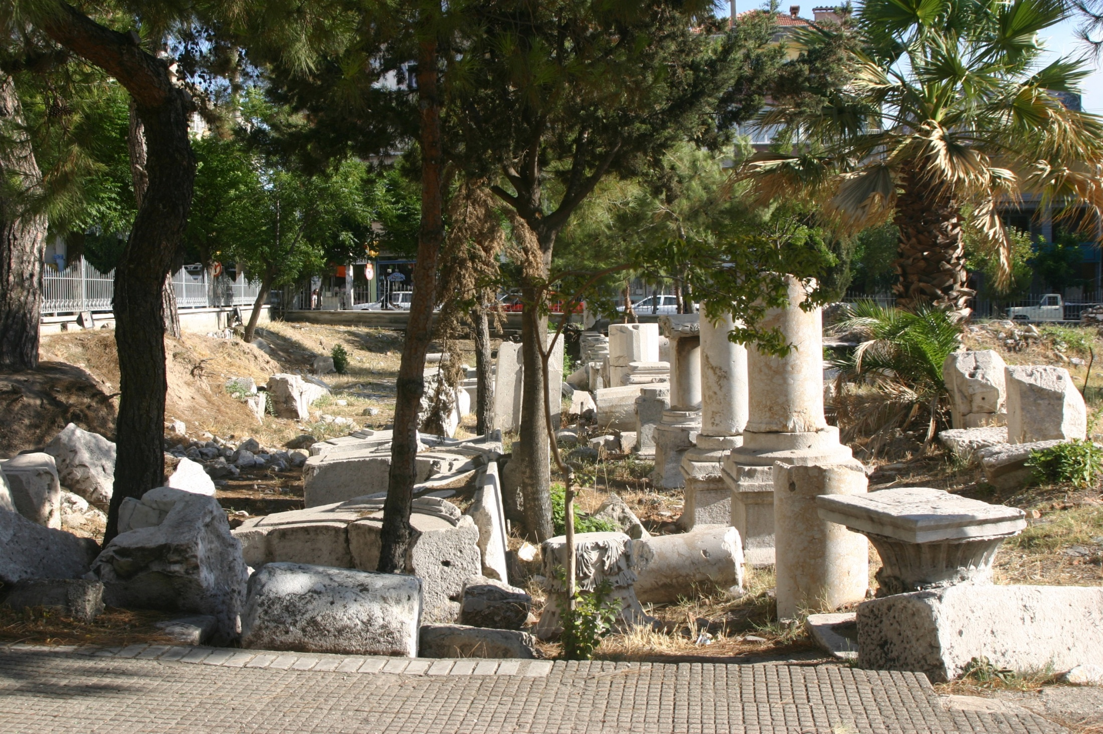
Remnants of ancient Thyatira
.

Slide 6
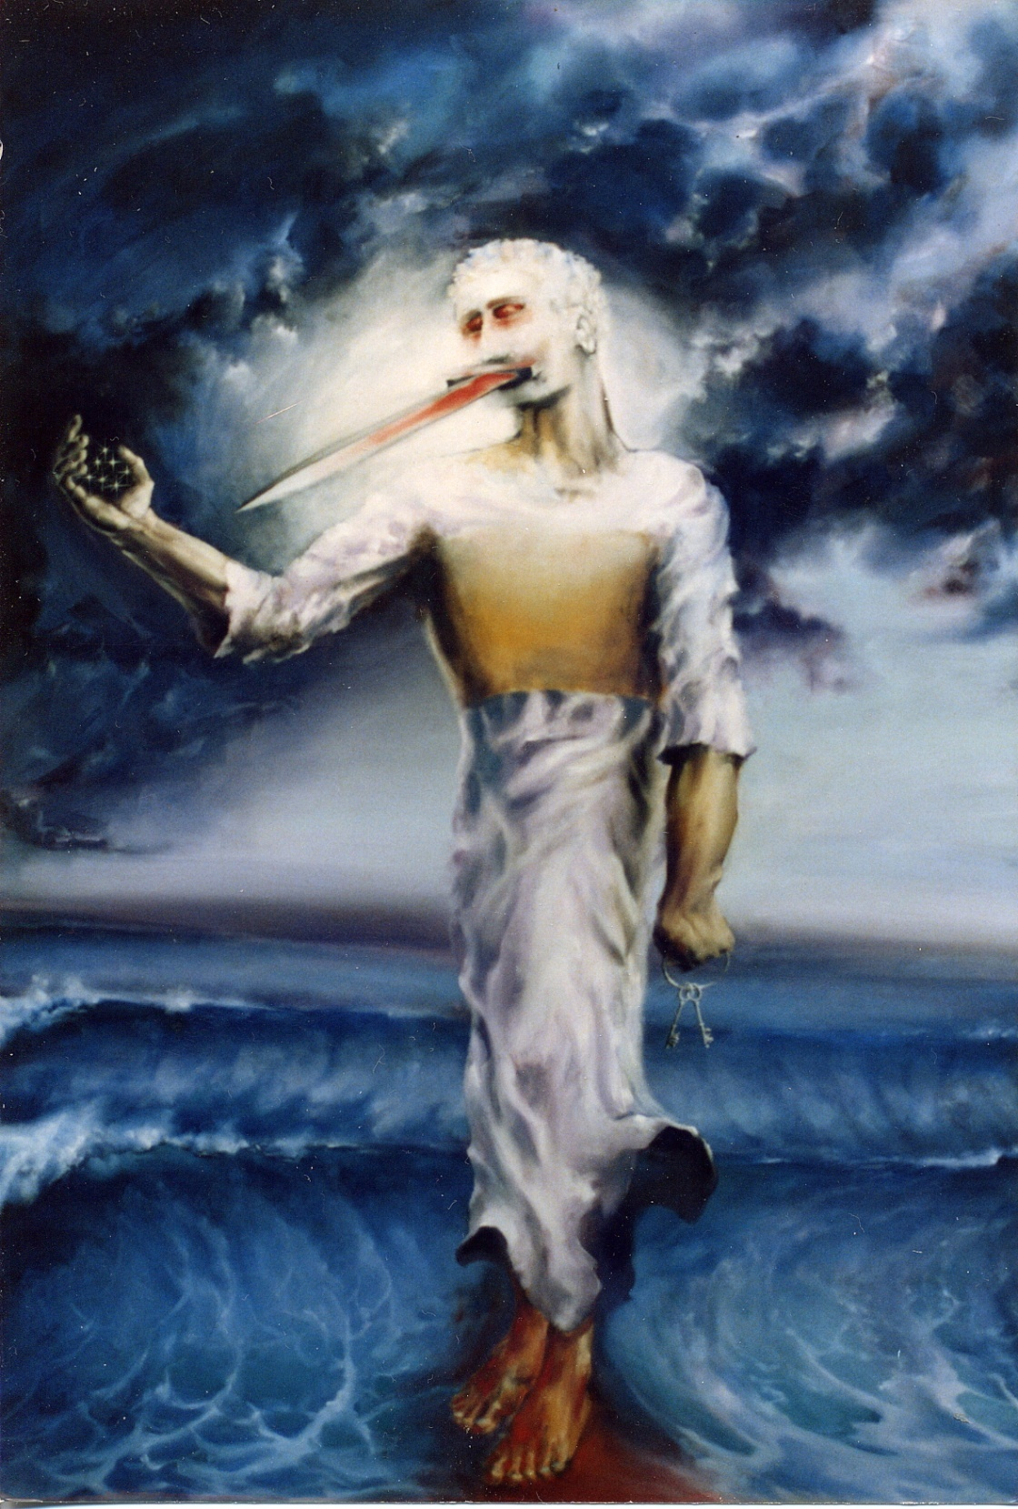
“Son of God”
The multitudinous Christ vision
“eyes like unto a flame of fire” - Cp. 1:14-15 = Anger of divine judgement.
“feet are like fine brass” – Symbol for the immortal judge – John 5:27.
Exercising dominion as ‘the Son of man’

Slide 7
REVELATION 2
¹⁸ And unto the angel of the ecclesia in Thyatira write; These things saith the Son of God, who hath his eyes like unto a flame of fire, and his feet are like fine brass;
¹⁹ I know thy works, and love, and service, and faith, and thy patience, and thy works; and the last to be more than the first.
²⁰ Notwithstanding I have against thee, because thou sufferest that woman Jezebel, which calleth herself a prophetess, to teach and to seduce my servants to commit fornication, and to eat things sacrificed unto idols.
²⁴ But unto you I say, and unto the rest in Thyatira, as many as have not this doctrine, and which have not known the depths of Satan, as they speak; I will put upon you none other burden.
²⁵ But that which ye have already hold fast till I come.
Thyatira
Even when the faithful know and do many right things, an ecclesia can be endangered by false teachers.
We must steadfastly hold fast to the faith once delivered to the saints.

Slide 8
Thyatira – The compromising Ecclesia
Commended by Christ for:
works, love and service;
faith and endurance;
more works (focus on doing not doctrine).
But criticised for:
toleration of a seducing Jezebel class.
V.24 - Only one thing is required of them – eject the teachers of error from their midst!

Slide 9
Why judgement pending? - Apostasy
Thyatiran Epoch - AD 606 to 1572 when true witnessing came to an end - Jezebel ascendant in the Papal system.
Without purity of doctrine there is no salvation – 1 Tim. 4:12-16.
Allowing error to be taught results in shipwreck – 1 Tim. 1:19-20.
Proven teachers of error must be ejected – Titus 3:1-11; Gal. 1:8-9.

Slide 10
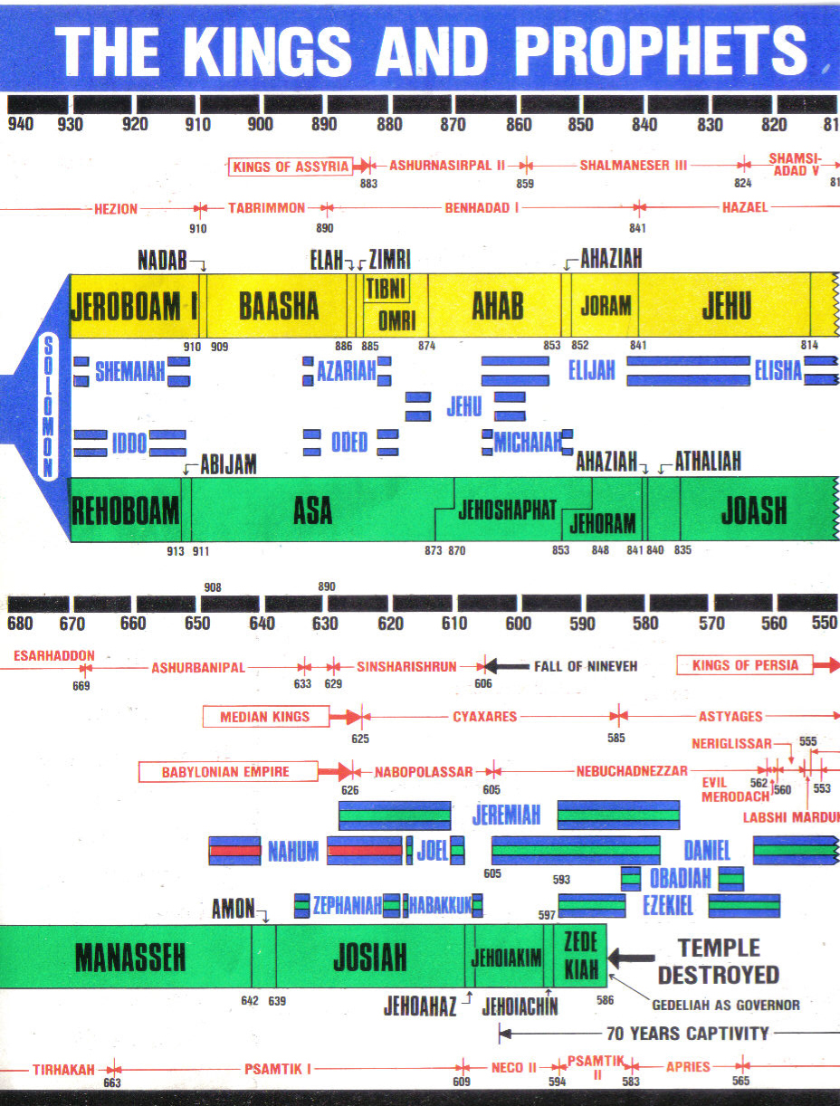
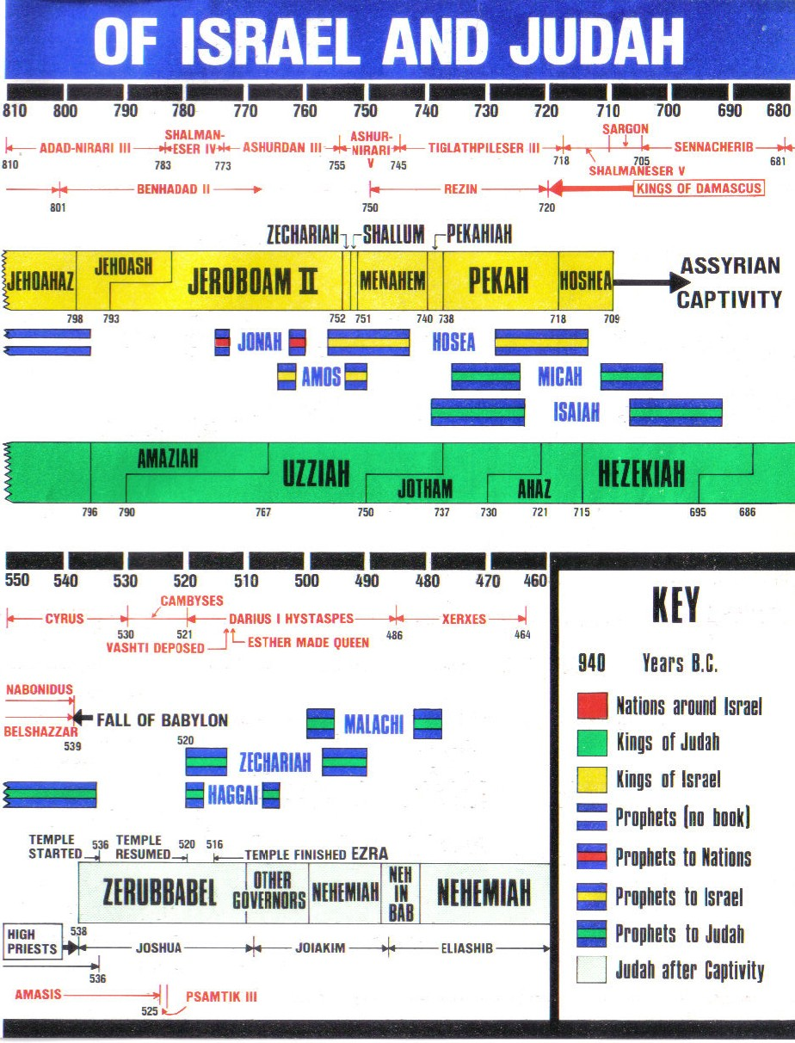
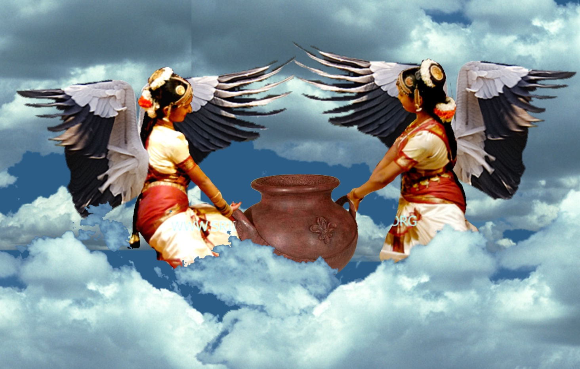
Babylonian apostasies in the Kings
Babylonian apostasy in Israel
Samaria
Babylonian apostasy
in Judah
Jerusalem
Zech. 5:9-11

Slide 11
The Omri and Ahab era
Omri city builder & statute maker –
1 Kings 16:23-28
Ahab -restorer of Baal worship & founder of apostate religion
1 Kings 16:31-34
Jezebel – “chaste”. Daughter of Ethbaal (“With or near Baal”) – Restoration of Amoritish worship in Israel – 1 Kings 21:25-26
Omri
Ahab & Jezebel
Athaliah
Omri – Builder of Samaria and statute-maker for Ahab (formula of Mic. 6:16) = Like Cush.
Ahab – Implementer of the ideologies of Omri – Builder of Canaanite worship = Nimrod.

Slide 12
The Omri and Ahab era
Athaliah – Harlot daughter and seducer of the ecclesia – Counsellor to Jehoram and Ahaziah
Ahab rebuilder of Baal worship & founder of apostate church
Jezebel – Mother of Harlots and teacher of Baal worship (Spiritual adultery)
Omri city builder & statute maker
Omri
Ahab & Jezebel
Athaliah
Jezebel – Mother of harlots – Type of Roman Catholic apostasy arising out of Brotherhood – Rev. 2:20-23.
Athaliah – Harlot daughter – Seducer, murderer and counsellor to Ahaziah – 2 Chron. 22:2-4.

Slide 13
God’s witnesses in the Ahab era
Ahab rebuilder of Baal worship & founder of apostate church
Elijah messenger of the Covenant & religious witness against apostate church
Obadiah – political witness working against apostate system to save Yahweh’s prophets
Omri city builder & statute maker
Omri
Ahab & Jezebel
Elijah – Yahweh’s prophet – Messenger of the Covenant = Religious witness – 3 and a half year ministry – Rev. 11:2-6.
Obadiah – Inside the government – Political witness – worked against persecuting harlot.

Slide 14
Fire from heaven –
1 Kings 18
Jezebel killed
Baal worshippers annihilated
Rome
Armageddon
House of Ahab annihilated
Beast and
False Prophet
30 years
Ahab
Jehoram
Jehu
Ahaziah
Fire from heaven on Mt. Carmel prepares Israel for conversion = Armageddon – Matt. 24:30.
Jezebel slain = Rome destroyed 10 years after Armageddon – Rev. 14:8.
Ahab’s house annihilated – Babylon the Great destroyed over 30 years – Rev. 14:9-11.
Baal worshippers annihilated - The False Prophet and ardent Catholics destroyed – Rev. 19:20.

Slide 15
Three parts of the Great City
Probable reference to the three ‘mouths’ (governments) of Rev.16:13 which make up “great Babylon” – dragon, beast, false prophet.
Also infers the order of destruction:
Dragon = Russian power (eastern leg of the Image) based in Constantinople. Gog destroyed in the Land of Israel.
Beast = European nations (reformed Holy Roman Empire). Subdued over period of 40 years of conflict after Armageddon.
False prophet = Papacy. Last enemy to be destroyed before Kingdom fully established.

Slide 16
Harvest
Papacy
Vintage

Slide 17
Elijah on Mt. Horeb 1 Kings 19
Some in Israel ready to listen
Wind
Hazael
“the voice of a
gentle whisper”
“passed by”
“passed by”
“What doest thou here, Elijah?”
Earthquake
Jehu
“passed by”
“passed by”
“What doest thou here, Elijah?”
Fire
Elisha
“passed by”
“son of judgement” and “prophet” – God’s voice in Israel
“the voice of a
gentle whisper”

Slide 18
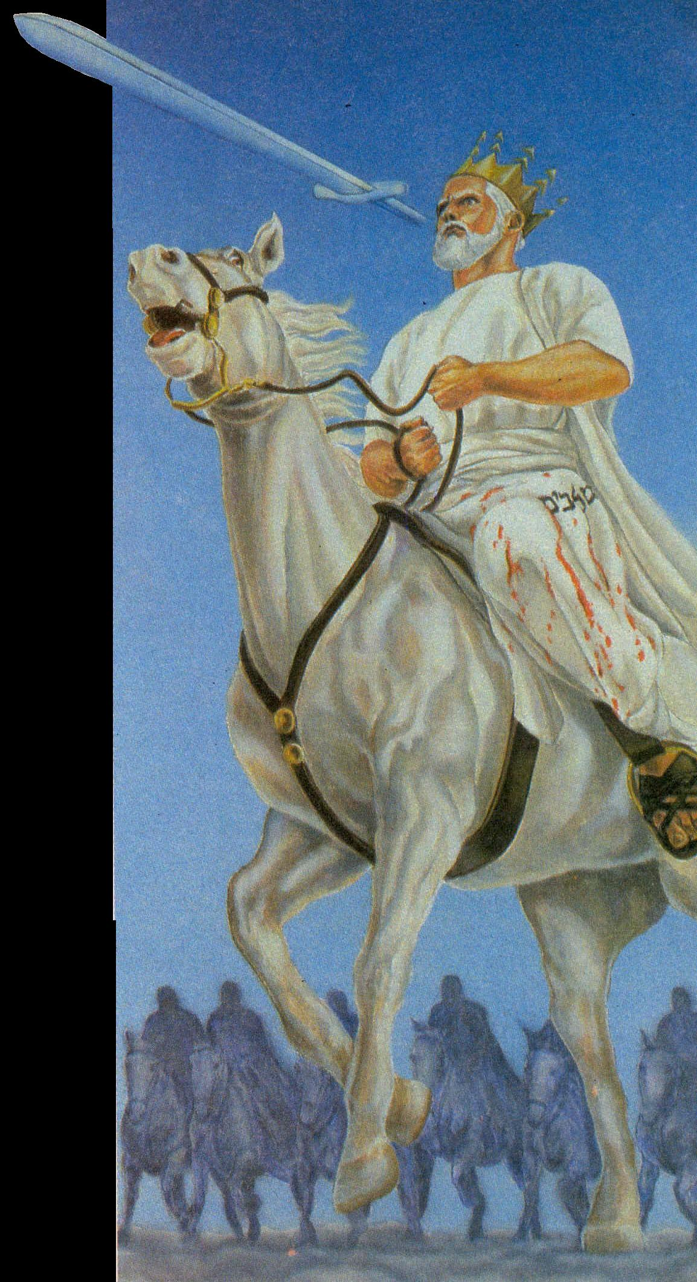
Rev. 19:19-20
¹⁹ And I saw the beast, and the kings of the earth, and their armies, gathered together to make war against him that sat on the horse, and against his army.
²⁰ And the beast was taken, and with him the false prophet that wrought miracles before him, with which he deceived them that had received the mark of the beast, and them that worshipped his image. These both were cast alive into a lake of fire burning with brimstone.
Jezebel trampled by horses = Israel under Elijah – Isa. 63:13; Zech. 10:3.

Slide 19
Great Babylon divided into 3 parts Rev. 16:16-21
Everyone that is left of all the nations
Wind - Hazael
Dragon judged
“the voice of a gentle whisper” – “He shall come down like rain on the mown grass” – Ps. 72:6
“passed by”
Gog
“passed by”
Beast judged
Earthquake - Jehu
Europe
“passed by”
“passed by”
Fire - Elisha
False Prophet judged
“…and he shall speak peace unto the nations: and his dominion shall be from sea to sea, and from the river to the ends of the earth.” – Zech. 9:10.
“passed by”
Pope
“the voice of a
gentle whisper”
“Prophet like unto Moses” – God’s voice in the earth

Slide 20
Events of the Jubilee Period
50 years
Marriage
of Lamb
Yahweh Sabaoth manifested in power
for 40 years but the glory concealed
Elijah’s mission to scattered Jewry
THE SECOND EXODUS OF ISRAEL
Return of Christ - Resurrection
Judgement Seat
Arabs subdued
The smiting and healing of Egypt
Christ’s universal rule over all nations
Judah saved and settled in Land
10 years
Gog buried – Land cleansed & divided
40 years
ARMAGEDDON
Rome destroyed
Mid-heaven
Proclamation
10 years
Catholic Europe destroyed – 30 years
Marriage
Supper
Britain submits
All nations submit to Christ
Temple built

Slide 21
The promise will be kept! Rev 2:26-27
And he that overcometh, and keepeth my works unto the end, to him will I give power over the nations:
And he shall rule them with a rod of iron; as the vessels of a potter shall they be broken to shivers: even as I received of my Father.
And I will give him the morning star.
Drawn from Ps. 2:8-9 – Prophecy of the Vintage of the Earth

Slide 22
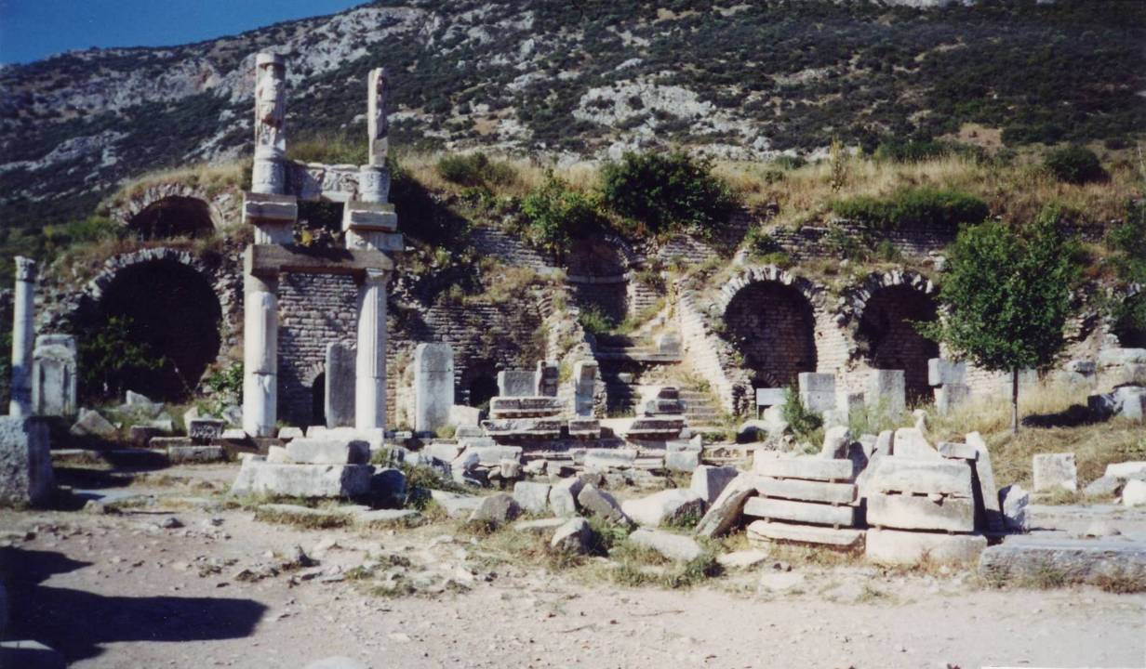
Thyatira today
“…as the vessels of a potter shall they be broken to shivers: even as I received of my Father.”

Slide 23
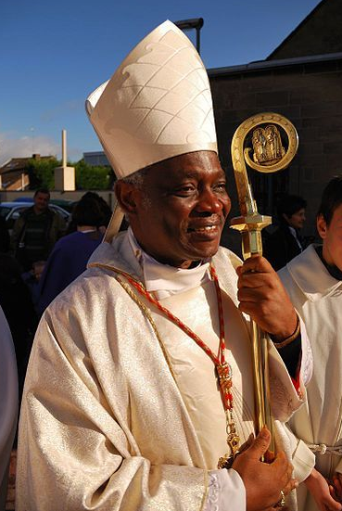
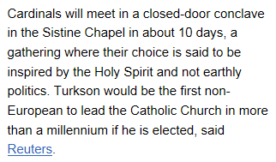
What are the prospects of a black pope?
Peter Turkson

Slide 24
Complete fulfilment of Rev. 16:14
Rev. 16:14 - For they are spirits of demons, doing signs, which are to go forth unto the kings of the whole habitable earth, to gather them together unto the battle of the great day of God the Almighty. (Roth.)
Until recently the election of a black US president was impossible – Liberty, Equality and Fraternity changed all that.
Today it is readily accepted by most.
The election of a black pope would bring the work of the three unclean spirits to maturity.

Slide 25
Nimrod founded the kingdom of men – Gen. 10:10
At Armageddon Christ will begin the 40 year process of destroying the kingdom of men – it would be fitting that either then or in 2060 the pope of the time was black in skin colour matching Nimrod.
Rev. 11:15 - Then the seventh angel blew his trumpet, and there were loud voices in heaven, saying, “The kingdom of the world has become the kingdom of our Lord and of his Christ, and he shall reign for ever and ever.” (RSV)

Slide 26
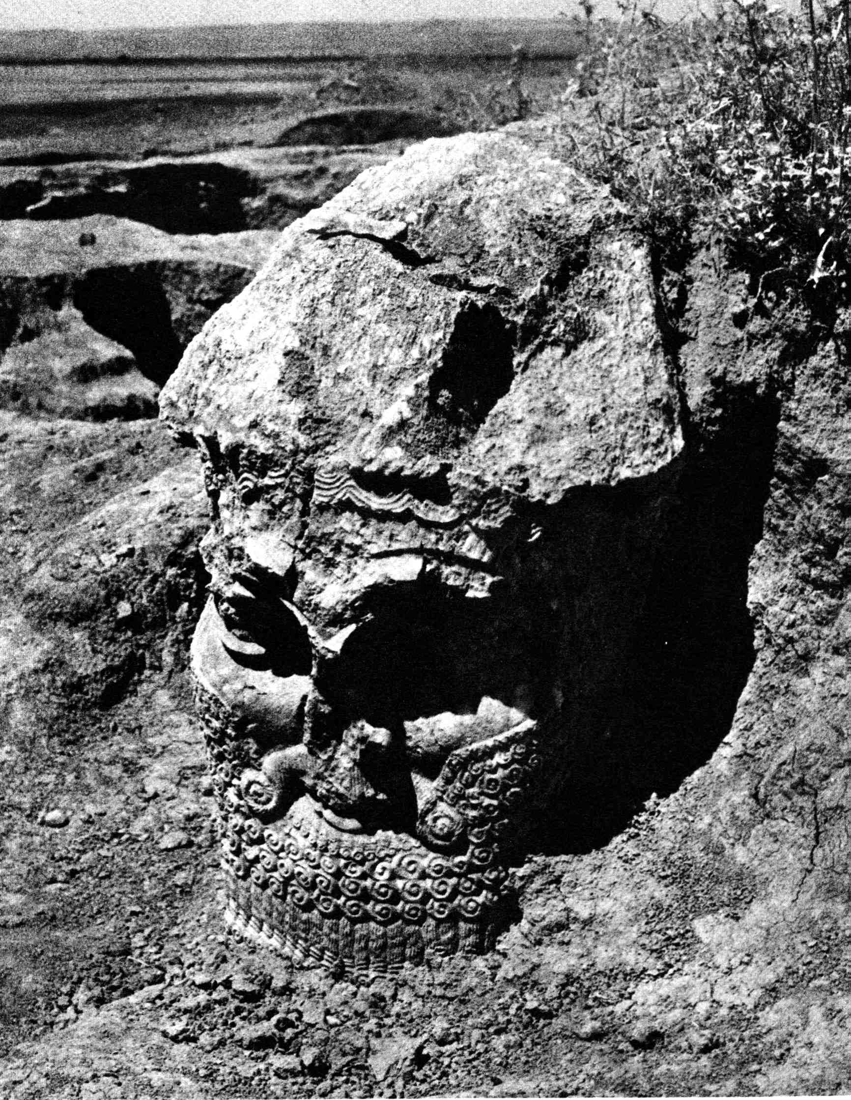
The possibility of a black pope
His name means - “The Rebel” or “We will rebel”.
The rationale
The only known visage of Nimrod is negroid in features – a descendent of Ham – Gen. 10:6-8
Nimrod – 13th generation from Adam – first god-king – founder of the kingdom of men.
The Letters to the Seven Ecclesias

Slide 27
“Cush begat Nimrod” – Gen. 10:8
“Nimrod ben Cush” – Has a numerical value of 666
Nimrod
N = 50
M = 40
R = 200
D = 4
Ben
B = 2
N = 50
Cush
K = 20
SH = 300
294
52
320
= 666
The Letters to the Seven Ecclesias

Slide 28
Cush – Father of Nimrod
History records that Cush – also called Kish and Bel (Baal) – settled in Babylon first.
Cush was the great original prophet of the Babylonian mysteries (Catholic catechism).
Bel = “the confounder” - of languages and of religion – Isa. 46:1; Jer. 50:2; 51:44. Chaldean – “to break in pieces, scatter abroad.”
Bel was later called Baal and Janus.
Cush began the form of false religion that spread throughout Mesopotamia and Canaan.
Principle – Mic. 6:16 – “For the statutes of Omri are kept, and all the works of the house of Ahab”.
The Letters to the Seven Ecclesias

Slide 29
Pontiff – Where from?
The Pope is acknowledged as the Pontifex Maximus of the Roman Church.
Title of pagan Roman emperors who were official high priests of the pagan mysteries.
The title can be traced back to Nimrod.
The supreme pontiff of paganism bore the Chaldean title PETER or Interpreter of the Mysteries.
The office of Pontifex Maximus, or chief priest, was to declare and interpret the divine law and preside over sacred rites.

Slide 30
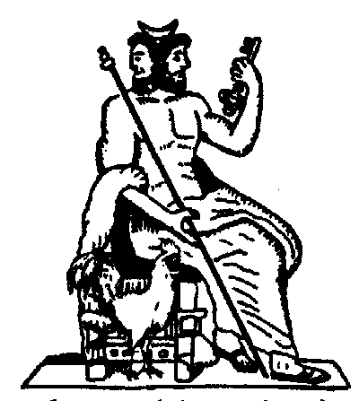
Janus - Roman version of Nimrod
The god of doors and gateways, and also of beginnings – hence the month January.
Temple doors faced east and west (for beginning and ending of day) - between stood his statue, with two faces gazing in opposite directions.
One face was young, the other old – i.e. Nimrod reincarnated in Tammuz.
His symbols were a key and a cock.
Cardinals (from the Latin ‘cardo’ = hinges) derived from the priests of Janus – god of doors and hinges – ordained by Semiramis.

Slide 31
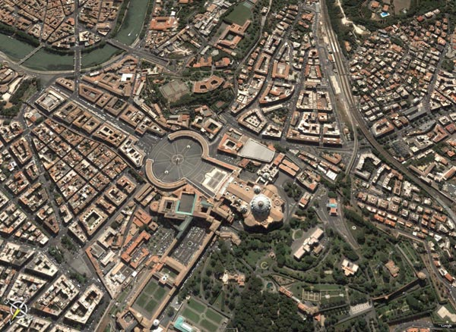
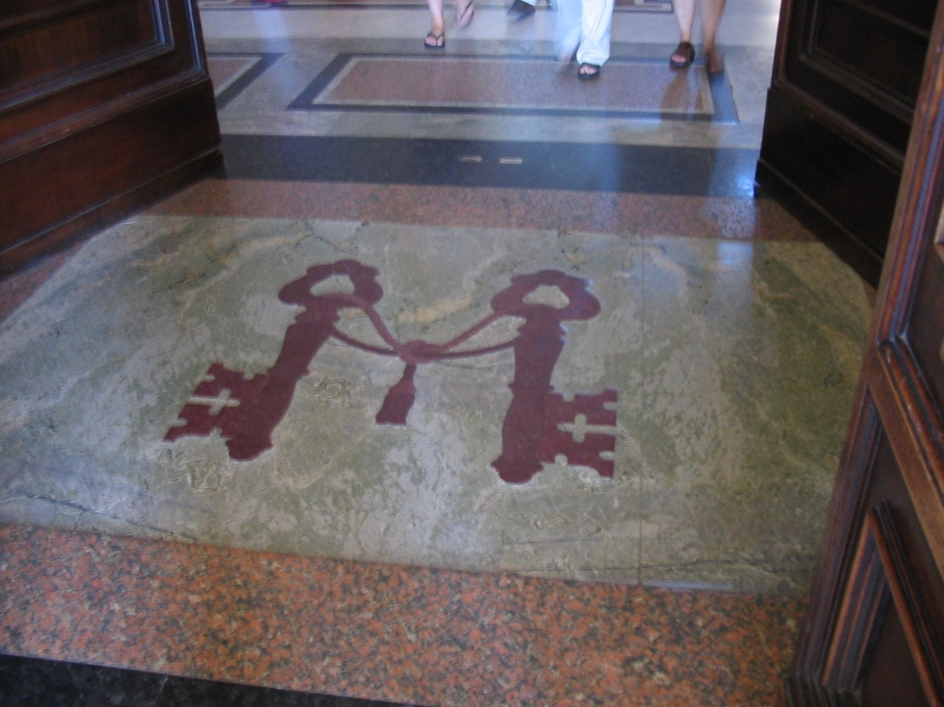
The sanctuary of the Pontifex Maximus
The Key of Janus
The perfect place for Nimrod’s successor
The Vatican faces due east!

Slide 32
Next study… God willing
“I know thy works”
Study 4 – “The challenge of keeping our garments white”

Slide 33
///
.

